Slide 1
What is Knowledge?
Introduction to Philosophy
Philosophy 100
Class 8

Slide 2
Overview
Conceptual analysis:
Necessary conditions
Sufficient Conditions
Necessary and Sufficient Conditions
Analyze “knowledge”
What are the necessary and sufficient conditions for knowledge?
Are there counterexamples?
What more is needed for the traditional (JTB) account of knowledge?

Slide 3
Conceptual Analysis: Necessary and Sufficient Conditions
Necessity
Sufficiency
X is necessary for Y if Y cannot occur without X occurring.
A necessary condition for getting an A in PHIL 100 (Y) is writing all of the exams (X).
X is sufficient for Y if the occurrence of X ensures the occurrence of Y.
A sufficient condition for getting an A in PHIL 100 (Y) is to get 85% or higher on all of the exams and assignments (X).
Notice that writing all of the exams is not sufficient for an A in this class and that getting an 85% or higher on all of the exams and assignments is not necessary to get an A

Slide 4
Conceptual Analysis
The Philosopher’s means of testing a concept through analysis is to determine whether or not the concept’s conditions are independently necessary and jointly sufficient.

Slide 5
Conceptual Analysis
What are the necessary and sufficient conditions for one to be a bachelor?
Bachelor = unmarried male.
S is a bachelor iff (if and only if):
S is unmarried
S is a male
Are these conditions each necessary and jointly sufficient? Can we think of a counter example that satisfies these conditions but isn’t a bachelor?

Slide 6
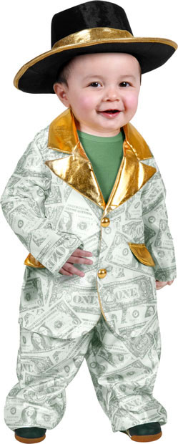
Bachelor
Conceptual Analysis
Bachelor =
unmarried adult male.
S is a bachelor if and only if:
S is unmarried
S is a male
S is an adult

Slide 7
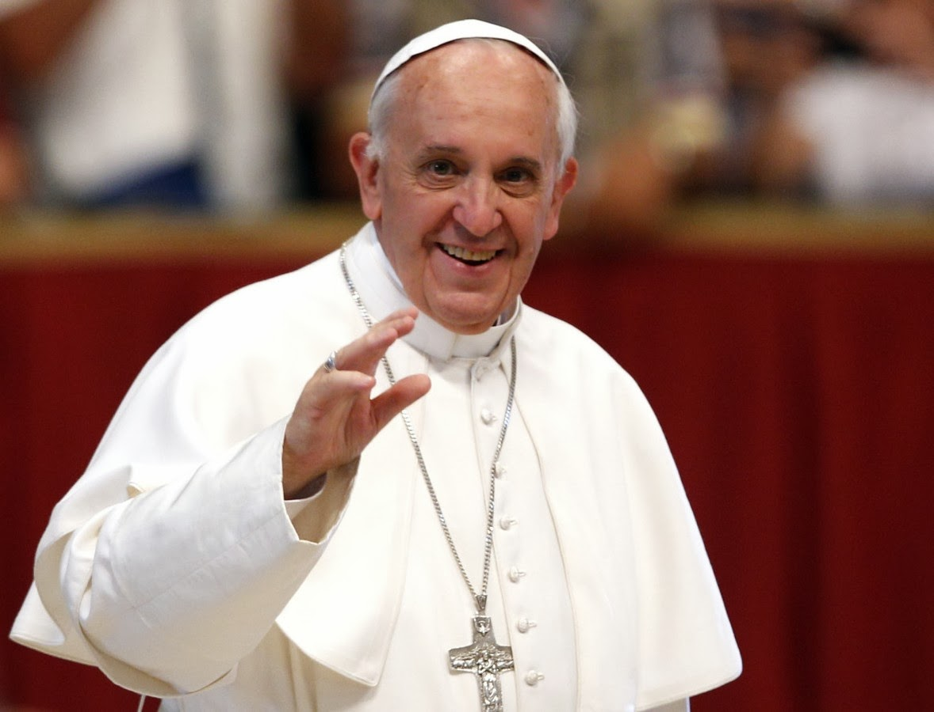
Bachelor?
?

Slide 8
What is knowledge?
A Conceptual Analysis

Slide 9
What is knowledge?
Three types of knowledge:
Knowledge that (Propositional)
Knowledge that. “I know that Earth’s moon is named Luna.”
Know how
Samwise knows how to cook tasty taters.
Know who
Trinity knows Neo.
We will be focusing on propositional knowledge.

Slide 10
What Is Knowledge?
We want to know what it is that we’re referring to when we use the term “knows.”
We can define knowledge by giving necessary and sufficient conditions for knowing that something is the case. But how might we do that?
Consider first the following claims, each of which you know:
I am in philosophy class.
It is not summer.
Four and four equal eight.
What is it about the relationship between you and each of these propositions that might help us define knowledge—i.e. provide the necessary and sufficient conditions knowledge?

Slide 11
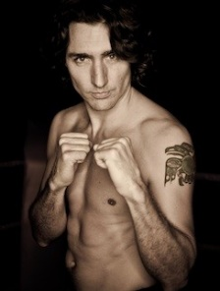
Knowledge
Consider the following proposition:
P: Justin Trudeau is Canada’s current Prime Minister.
P is something we know, but in virtue of what do we know it?
S knows that p iff: ?

Slide 12
Two Straightforward Conditions
Truth
Belief
It seems straightforward that you cannot know a falsehood.
For example, what would you think if someone made the following statements?
I know that Justin Trudeau is not the current Prime Minister of Canada.
It also seems fairly straightforward that you cannot know a proposition if you do not believe that proposition.
For example:
I know that JT is our current Prime Minister, but I don’t believe it.

Slide 13
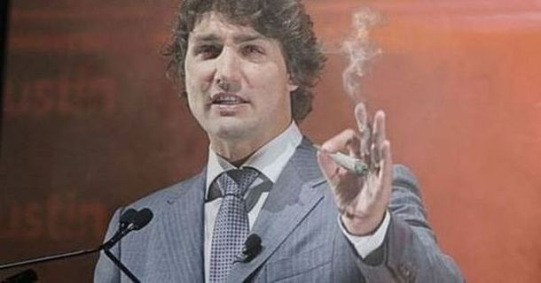
Knowledge
So we have two necessary condition for knowledge, but are they sufficient?
S knows that p iff:
S believes that P.
It is true that P
Can we think of a situation where these conditions are satisfied – one has a true belief – but where one doesn’t know?
Here is a case where someone has a true belief, but do we think this person knows that JT is Canada’s current Prime Minister?
No, so it seems like we need another condition.
What about:
I know that JT is Canada’s current PM because a gnome told me during a drug induced vision.

Slide 14
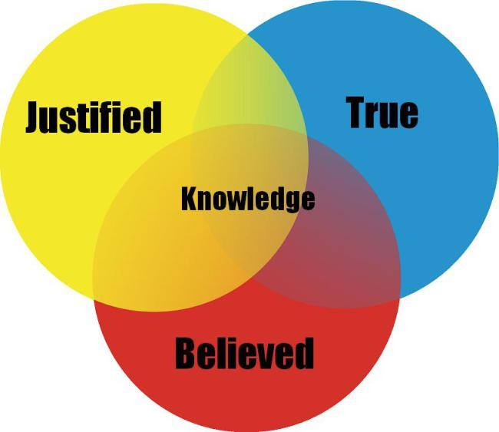
TAK: Knowledge = Justified True Belief
S knows that p iff:
p is true.
S is believes that p.
S is entitled (is justified) to believe that p.
Example:
Sam knows that JT is Canada’s current PM because JT is Canada’s current PM, Sam believes that JT is Canada’s current PM, and Sam is justified in believing that JT is Canada’s current PM.

Slide 15
How are beliefs justified?
Internalism
Externalism
One thought is that epistemic reasons, or evidence, justify our beliefs, and these reasons are held by some individual. The leading internalist view holds that
A belief B is justified for S at time t iff S’s total evidence at t supports that P.
Another thought is that our beliefs are justified by the way in which those beliefs are formed. The leading externalist view is put in terms of reliability:
A belief B is justified for S at t, iff S’s B was brought about by a reliable process.

Slide 16
Internalism
Potential Pros
Potential Cons
Intuitive
Avoids tricky counterexamples
True temp, Norman, etc.
Seems to correctly produce those cases where a person seems to be justified—i.e. avoids counterexample.
Needs to accounts for the regress problem.
Foundationalism: Some beliefs are basic, meaning they do not require additional beliefs for their justification.
We need an account of basicness.
Coherentism: Given a broad enough coherent belief set, a belief can be justified simply in virtue of its coherence with other beliefs within that set.
Isolation problems
These can be avoided if we accept non-propositional experiences as evidence.

Slide 17
Externalism
Potential Pros
Potential Cons
Avoids regress problems
Avoids isolation problems
Provides an entirely naturalistic (scientific) account of justification
Leading views produce unintuitive results:
New Evil Demon
True temp
Big problem: Generality:
Every belief is result of numerous processes with various degrees of generality. We need an account of which processes specifically are the one’s that justify in general. Without that, we don’t even have a theory.

Slide 18
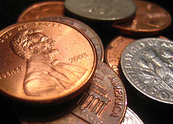
Challenges to TAK: GETTIER CASES
A Gettier case is a counterexample to the definition of knowledge as justified true belief with the following features:
(i) p is true.
(ii) One is sure that p is true.
(iii) One is sure that p is true on the basis of a valid inference to p from q.
(iv) One has good evidence for q, but
(v) q is false.

Slide 19
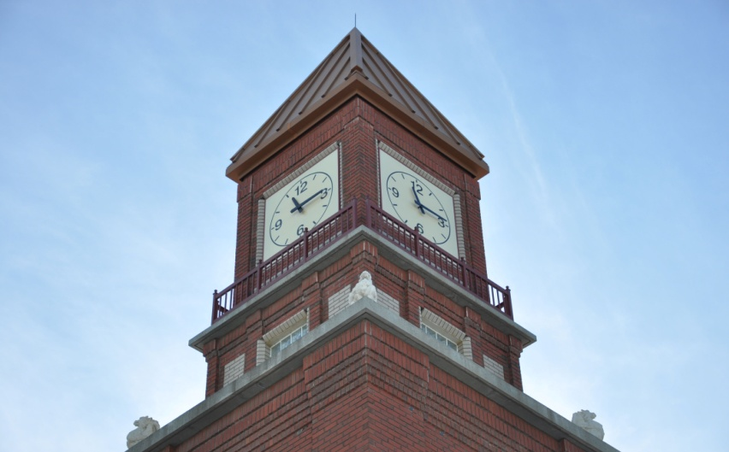
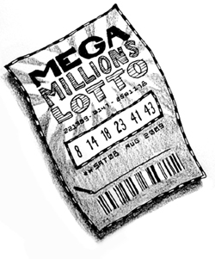
More Gettier Cases
Russell’s Clock
Inductive Support Gettier Case
Walking to school Jay uses the same clock tower everyday to gauge the time she has before class starts. Today she observes the clock saying it is 11:15. Unbeknownst to her, the clock stopped working exactly 12 hours earlier. Does Jay know that it is 11:15?
Lottery Ticket
Probabilistic Gettier Case
Ramone purchases a lottery ticket. He knows that there are 1 million tickets that have been sold, so he knows that he has a 1/1000000 chance of winning, which means he has a .999999 chance of losing. Mathematically, .999999 is the equivalent to 100%. So Ramone is sure that he has a losing tickety. In fact, he does have a losing ticket. Did Ramone know he had a losing ticket?

Slide 20


